Slide 1



Slide 2

Genesis: The Book of Beginnings
Key concepts to cover
Main teaching points
Important topics
Discussion points
Notes:
Key concepts to cover: Discuss the main concepts and theories that students need to understand for this topic.
Main teaching points: Highlight the most important learning objectives and key takeaways from this section.
Important topics: Cover the essential topics that form the foundation of understanding for this subject area.
Discussion points: Encourage student participation by asking questions and facilitating group discussions about the material.

Slide 3

Creation of Cosmos and Life
Key concepts to cover
Main teaching points
Important topics
Discussion points
Notes:
Key concepts to cover: Discuss the main concepts and theories that students need to understand for this topic.
Main teaching points: Highlight the most important learning objectives and key takeaways from this section.
Important topics: Cover the essential topics that form the foundation of understanding for this subject area.
Discussion points: Encourage student participation by asking questions and facilitating group discussions about the material.

Slide 4

Adam, Eve, and the Fall
Key concepts to cover
Main teaching points
Important topics
Discussion points
Notes:
Key concepts to cover: Discuss the main concepts and theories that students need to understand for this topic.
Main teaching points: Highlight the most important learning objectives and key takeaways from this section.
Important topics: Cover the essential topics that form the foundation of understanding for this subject area.
Discussion points: Encourage student participation by asking questions and facilitating group discussions about the material.

Slide 5

Cain and Abel: First Murder
Key concepts to cover
Main teaching points
Important topics
Discussion points
Notes:
Key concepts to cover: Discuss the main concepts and theories that students need to understand for this topic.
Main teaching points: Highlight the most important learning objectives and key takeaways from this section.
Important topics: Cover the essential topics that form the foundation of understanding for this subject area.
Discussion points: Encourage student participation by asking questions and facilitating group discussions about the material.

Slide 6

Noah's Ark and Flood
Key concepts to cover
Main teaching points
Important topics
Discussion points
Notes:
Key concepts to cover: Discuss the main concepts and theories that students need to understand for this topic.
Main teaching points: Highlight the most important learning objectives and key takeaways from this section.
Important topics: Cover the essential topics that form the foundation of understanding for this subject area.
Discussion points: Encourage student participation by asking questions and facilitating group discussions about the material.

Slide 7
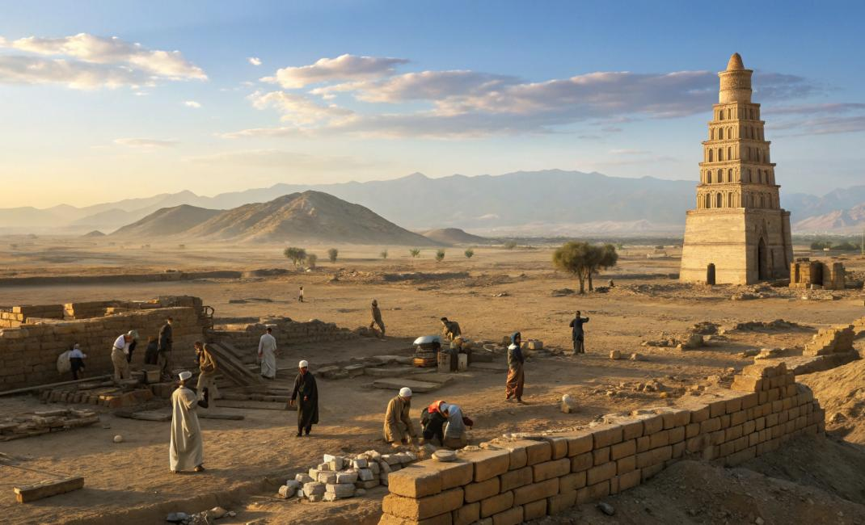
Tower of Babel: Pride and Dispersion
Key concepts to cover
Main teaching points
Important topics
Discussion points
Notes:
Key concepts to cover: Discuss the main concepts and theories that students need to understand for this topic.
Main teaching points: Highlight the most important learning objectives and key takeaways from this section.
Important topics: Cover the essential topics that form the foundation of understanding for this subject area.
Discussion points: Encourage student participation by asking questions and facilitating group discussions about the material.

Slide 8

The Call of Abraham
Key concepts to cover
Main teaching points
Important topics
Discussion points
Notes:
Key concepts to cover: Discuss the main concepts and theories that students need to understand for this topic.
Main teaching points: Highlight the most important learning objectives and key takeaways from this section.
Important topics: Cover the essential topics that form the foundation of understanding for this subject area.
Discussion points: Encourage student participation by asking questions and facilitating group discussions about the material.

Slide 9
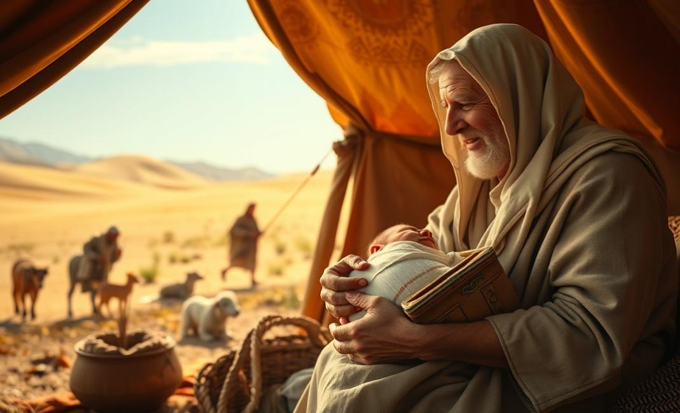
Abraham's Family: Isaac and Tests of Faith
Key concepts to cover
Main teaching points
Important topics
Discussion points
Notes:
Key concepts to cover: Discuss the main concepts and theories that students need to understand for this topic.
Main teaching points: Highlight the most important learning objectives and key takeaways from this section.
Important topics: Cover the essential topics that form the foundation of understanding for this subject area.
Discussion points: Encourage student participation by asking questions and facilitating group discussions about the material.

Slide 10
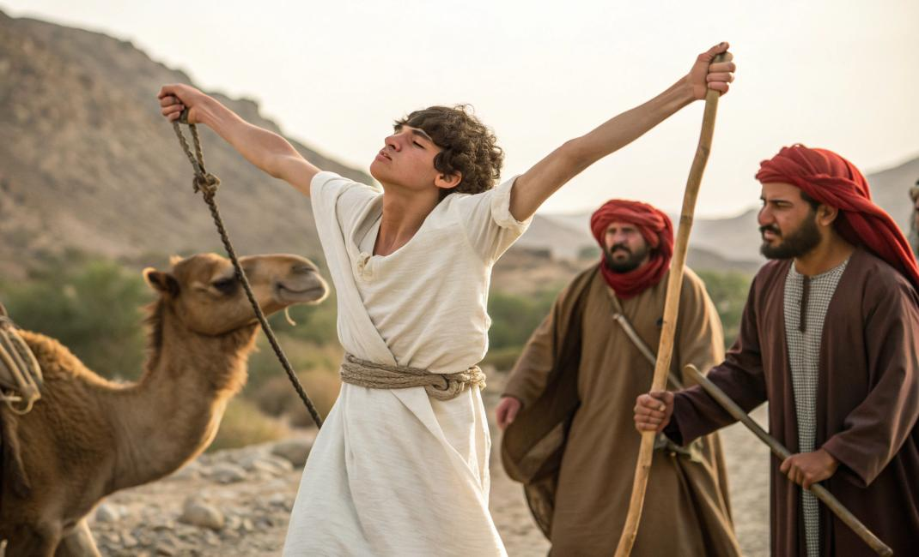
Jacob and Esau: Sibling Rivalry
Key concepts to cover
Main teaching points
Important topics
Discussion points
Notes:
Key concepts to cover: Discuss the main concepts and theories that students need to understand for this topic.
Main teaching points: Highlight the most important learning objectives and key takeaways from this section.
Important topics: Cover the essential topics that form the foundation of understanding for this subject area.
Discussion points: Encourage student participation by asking questions and facilitating group discussions about the material.

Slide 11
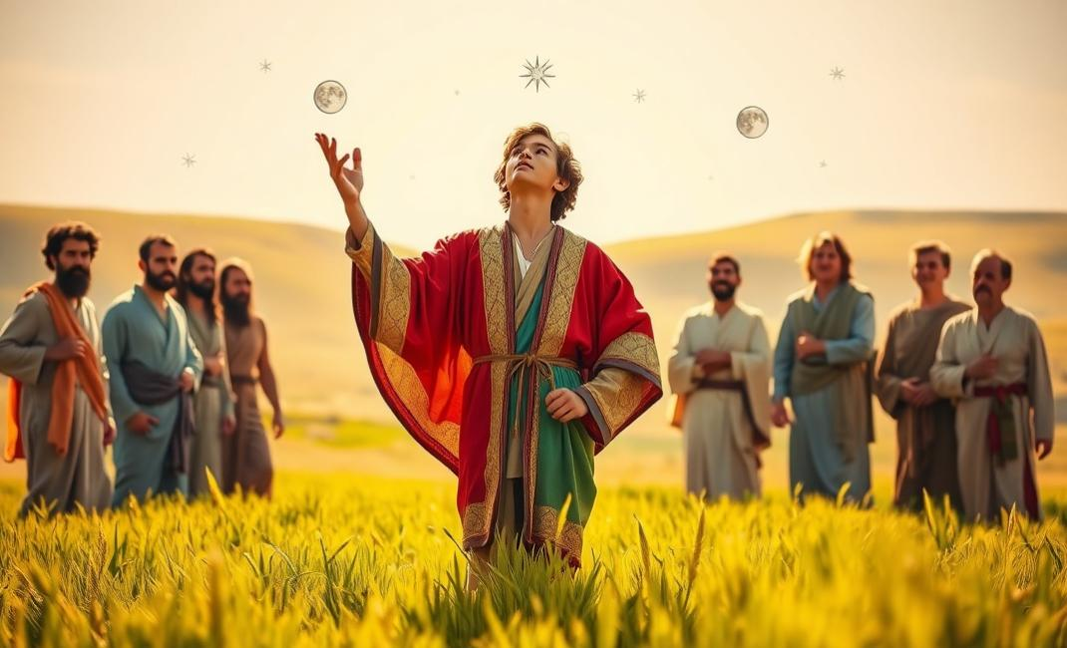
Joseph's Dreams and Betrayal
Key concepts to cover
Main teaching points
Important topics
Discussion points
Notes:
Key concepts to cover: Discuss the main concepts and theories that students need to understand for this topic.
Main teaching points: Highlight the most important learning objectives and key takeaways from this section.
Important topics: Cover the essential topics that form the foundation of understanding for this subject area.
Discussion points: Encourage student participation by asking questions and facilitating group discussions about the material.

Slide 12
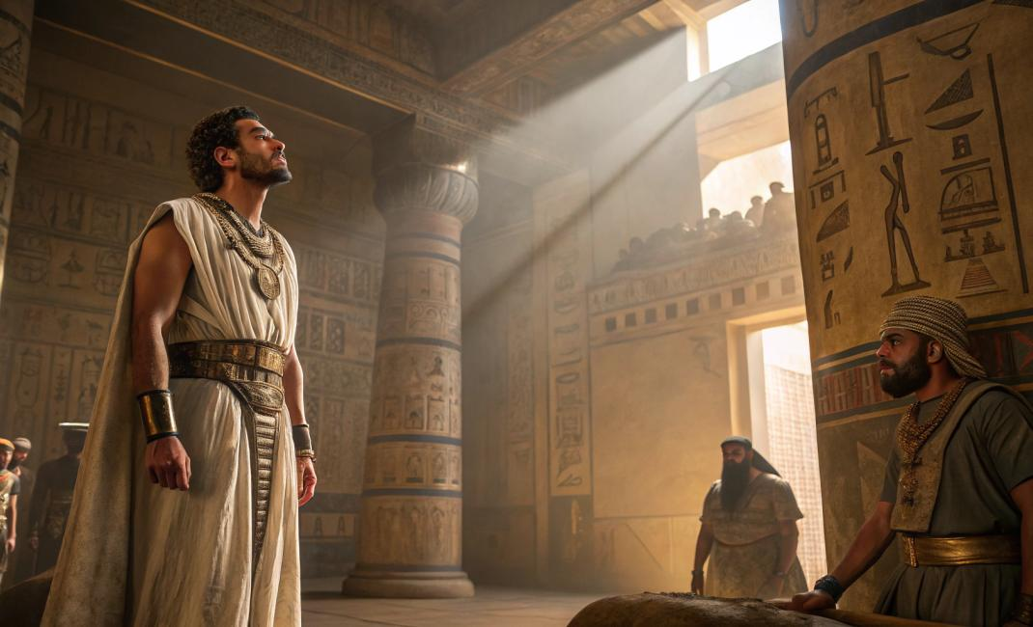
Joseph in Egypt: From Prison to Power
Key concepts to cover
Main teaching points
Important topics
Discussion points
Notes:
Key concepts to cover: Discuss the main concepts and theories that students need to understand for this topic.
Main teaching points: Highlight the most important learning objectives and key takeaways from this section.
Important topics: Cover the essential topics that form the foundation of understanding for this subject area.
Discussion points: Encourage student participation by asking questions and facilitating group discussions about the material.

Slide 13
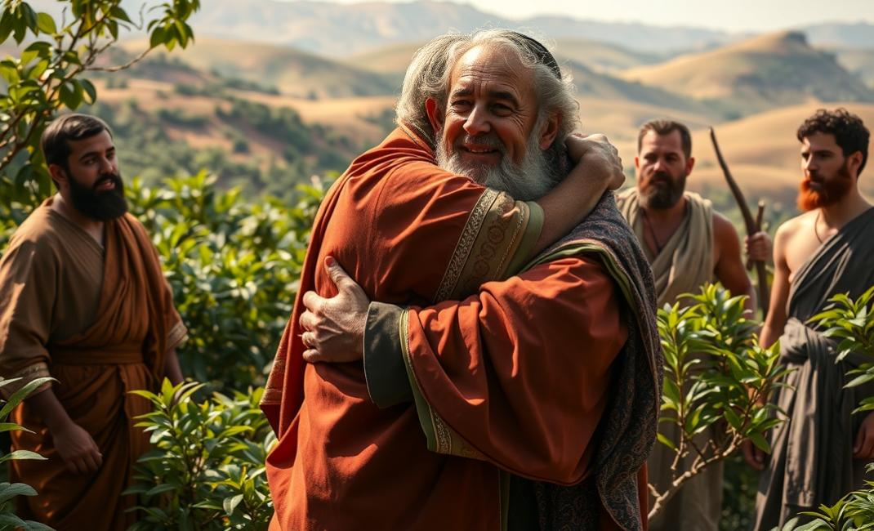
Joseph's Forgiveness and Family Reunion
Key concepts to cover
Main teaching points
Important topics
Discussion points
Notes:
Key concepts to cover: Discuss the main concepts and theories that students need to understand for this topic.
Main teaching points: Highlight the most important learning objectives and key takeaways from this section.
Important topics: Cover the essential topics that form the foundation of understanding for this subject area.
Discussion points: Encourage student participation by asking questions and facilitating group discussions about the material.

