Slide 1



Slide 2

Introduction to Geography
Key concepts to cover
Main teaching points
Important topics
Discussion points
Notes:
Key concepts to cover: Discuss the main concepts and theories that students need to understand for this topic.
Main teaching points: Highlight the most important learning objectives and key takeaways from this section.
Important topics: Cover the essential topics that form the foundation of understanding for this subject area.
Discussion points: Encourage student participation by asking questions and facilitating group discussions about the material.

Slide 3

Physical Geography - Tectonic Hazards
Key concepts to cover
Main teaching points
Important topics
Discussion points
Notes:
Key concepts to cover: Discuss the main concepts and theories that students need to understand for this topic.
Main teaching points: Highlight the most important learning objectives and key takeaways from this section.
Important topics: Cover the essential topics that form the foundation of understanding for this subject area.
Discussion points: Encourage student participation by asking questions and facilitating group discussions about the material.

Slide 4

Physical Geography - Weather and Climate
Key concepts to cover
Main teaching points
Important topics
Discussion points
Notes:
Key concepts to cover: Discuss the main concepts and theories that students need to understand for this topic.
Main teaching points: Highlight the most important learning objectives and key takeaways from this section.
Important topics: Cover the essential topics that form the foundation of understanding for this subject area.
Discussion points: Encourage student participation by asking questions and facilitating group discussions about the material.

Slide 5
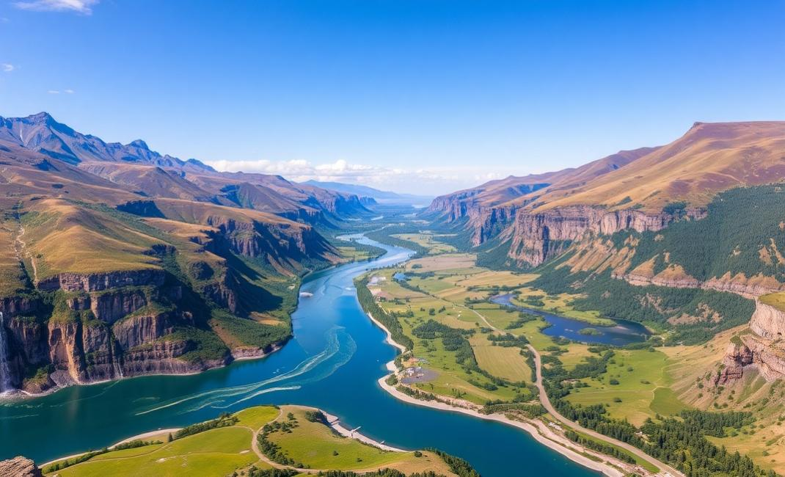
Physical Geography - Rivers and Coasts
Key concepts to cover
Main teaching points
Important topics
Discussion points
Notes:
Key concepts to cover: Discuss the main concepts and theories that students need to understand for this topic.
Main teaching points: Highlight the most important learning objectives and key takeaways from this section.
Important topics: Cover the essential topics that form the foundation of understanding for this subject area.
Discussion points: Encourage student participation by asking questions and facilitating group discussions about the material.

Slide 6

Human Geography - Urbanization
Key concepts to cover
Main teaching points
Important topics
Discussion points
Notes:
Key concepts to cover: Discuss the main concepts and theories that students need to understand for this topic.
Main teaching points: Highlight the most important learning objectives and key takeaways from this section.
Important topics: Cover the essential topics that form the foundation of understanding for this subject area.
Discussion points: Encourage student participation by asking questions and facilitating group discussions about the material.

Slide 7

Human Geography - Population
Key concepts to cover
Main teaching points
Important topics
Discussion points
Notes:
Key concepts to cover: Discuss the main concepts and theories that students need to understand for this topic.
Main teaching points: Highlight the most important learning objectives and key takeaways from this section.
Important topics: Cover the essential topics that form the foundation of understanding for this subject area.
Discussion points: Encourage student participation by asking questions and facilitating group discussions about the material.

Slide 8

Human Geography - Economic Development
Key concepts to cover
Main teaching points
Important topics
Discussion points
Notes:
Key concepts to cover: Discuss the main concepts and theories that students need to understand for this topic.
Main teaching points: Highlight the most important learning objectives and key takeaways from this section.
Important topics: Cover the essential topics that form the foundation of understanding for this subject area.
Discussion points: Encourage student participation by asking questions and facilitating group discussions about the material.

Slide 9
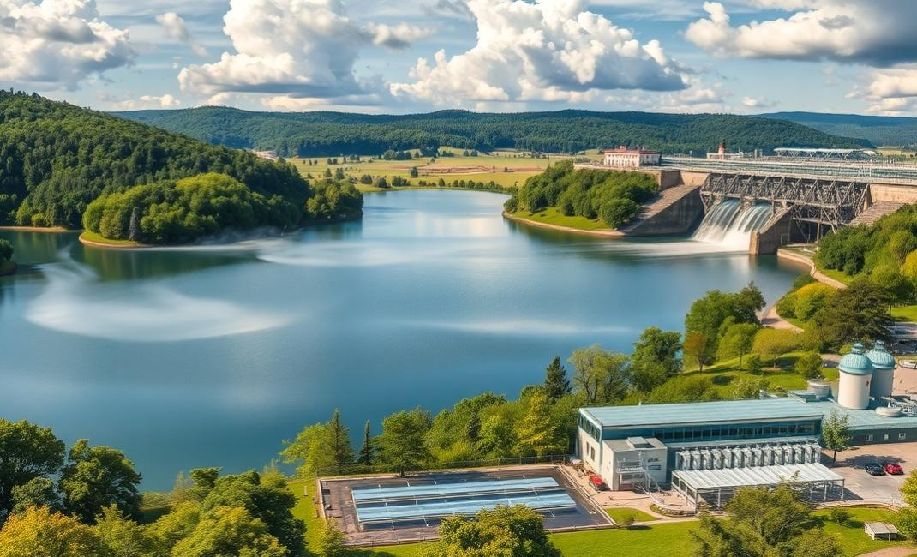
Environmental Geography - Resource Management
Key concepts to cover
Main teaching points
Important topics
Discussion points
Notes:
Key concepts to cover: Discuss the main concepts and theories that students need to understand for this topic.
Main teaching points: Highlight the most important learning objectives and key takeaways from this section.
Important topics: Cover the essential topics that form the foundation of understanding for this subject area.
Discussion points: Encourage student participation by asking questions and facilitating group discussions about the material.

Slide 10

Environmental Geography - Climate Change
Key concepts to cover
Main teaching points
Important topics
Discussion points
Notes:
Key concepts to cover: Discuss the main concepts and theories that students need to understand for this topic.
Main teaching points: Highlight the most important learning objectives and key takeaways from this section.
Important topics: Cover the essential topics that form the foundation of understanding for this subject area.
Discussion points: Encourage student participation by asking questions and facilitating group discussions about the material.

Slide 11

Geographical Skills - Map Reading
Key concepts to cover
Main teaching points
Important topics
Discussion points
Notes:
Key concepts to cover: Discuss the main concepts and theories that students need to understand for this topic.
Main teaching points: Highlight the most important learning objectives and key takeaways from this section.
Important topics: Cover the essential topics that form the foundation of understanding for this subject area.
Discussion points: Encourage student participation by asking questions and facilitating group discussions about the material.

Slide 12

Geographical Skills - Data Analysis
Key concepts to cover
Main teaching points
Important topics
Discussion points
Notes:
Key concepts to cover: Discuss the main concepts and theories that students need to understand for this topic.
Main teaching points: Highlight the most important learning objectives and key takeaways from this section.
Important topics: Cover the essential topics that form the foundation of understanding for this subject area.
Discussion points: Encourage student participation by asking questions and facilitating group discussions about the material.

Slide 13
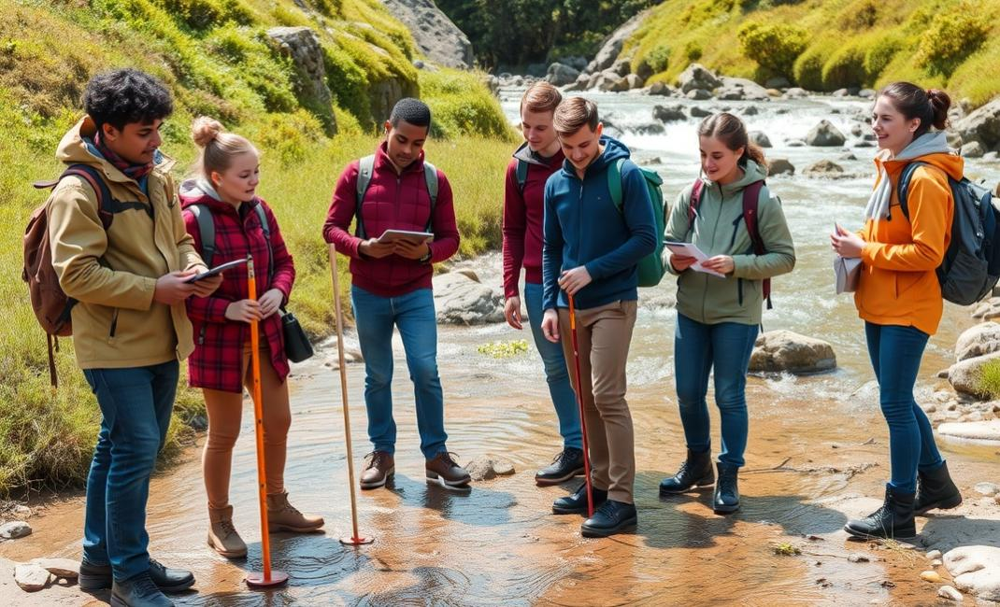
Fieldwork and Investigation
Key concepts to cover
Main teaching points
Important topics
Discussion points
Notes:
Key concepts to cover: Discuss the main concepts and theories that students need to understand for this topic.
Main teaching points: Highlight the most important learning objectives and key takeaways from this section.
Important topics: Cover the essential topics that form the foundation of understanding for this subject area.
Discussion points: Encourage student participation by asking questions and facilitating group discussions about the material.

